Slide 1

Wine Quality Analysis
Elias Turk

Slide 2
Contents
Objective
Data Description
Preprocessing and EDA (Exploratory Data Analysis)
Model Building
Insights from analysis

Slide 3
Objective
The dataset provided to us contains information about different constituents that contributes in the quality of Red Wine .
Management wants to know how different constituents affect the quality.
We will tackle this dataset using both classification and regression tasks to see which of these 2 techniques provides better results .
Regression:Wine quality is measured on 0(low)-10(high) scale.
Classification:(Good ~ 1 or Bad ~ 0) .

Slide 4
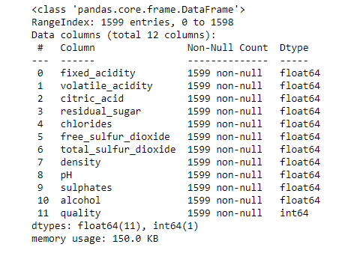
Data Description
This dataset contains : 12 columns and 1599 rows.
All independent variables are float.
Dependent variable “quality” is int.

Slide 5
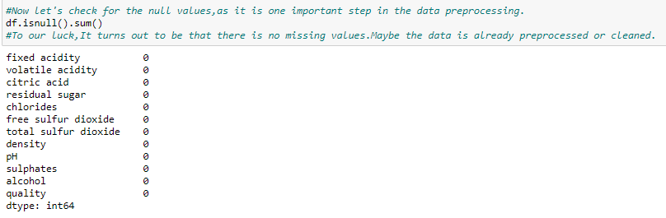
Preprocessing and EDA
After loading the data into the DataFrame in our jupyter NoteBook,we check if there is any null values:

Slide 6
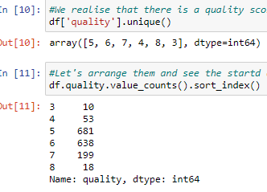
Preprocessing and EDA
Then I renamed the features in the columns and separated them with “ _ “ instead of spaces .
Then I displayed the unique values of quality and their count.

Slide 7
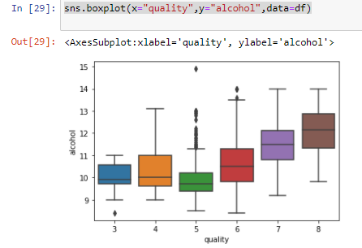
Preprocessing and EDA
As alcohol level increases, the wine quality increases as well!

Slide 8
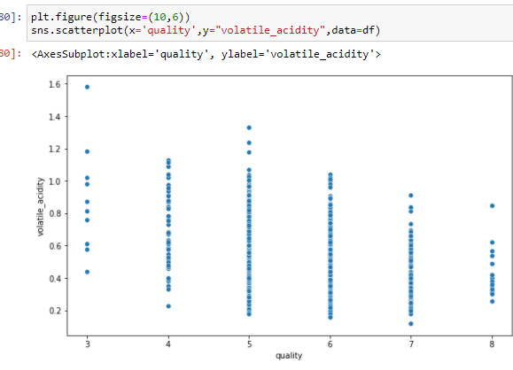
Preprocessing and EDA
Volatile_acidity and alcohol are the 2 most correlated variables with quality, however we can see that volatile_acidity is negatively correlated ,unlike alcohol.

Slide 9
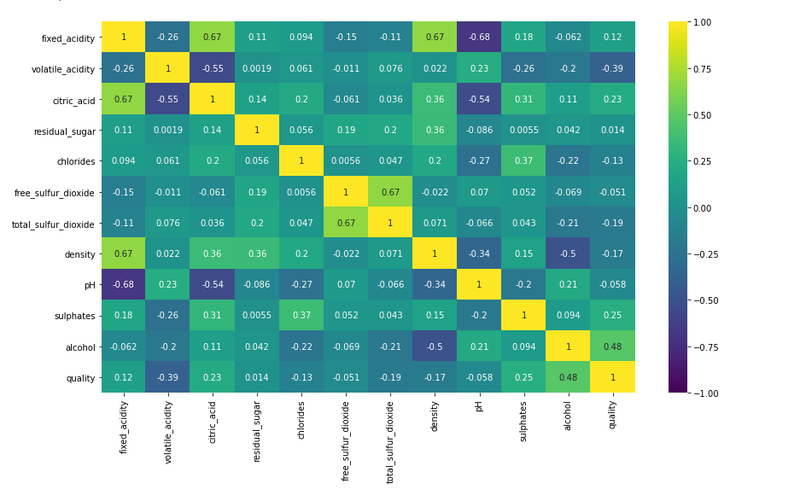
Preprocessing and EDA
After visualizing many aspects of the data and having spotted a huge correlation between some features with wine quality,I spotted that “alcohol”,”sulphates”,”citric_acid” have the highest positive correlation with quality.

Slide 10

Model Building
Firstly,to avoid confusion,I solved this task using Regression algorithm “Linear Regression” in a parallel notebook.
And because we were only displaying the Ordinary Least squares table , and because our dataset isn’t too large i did not split it.
I got an r-squared of 36.1% and adjusted R2 of 35.6% and because I have no experience in this field I removed variables with unsignificant p values > 0.05.
Second time I got relatively same results with a better ratio of r-squared to adjusted r-squared but the model didn’t get any better.

Slide 11
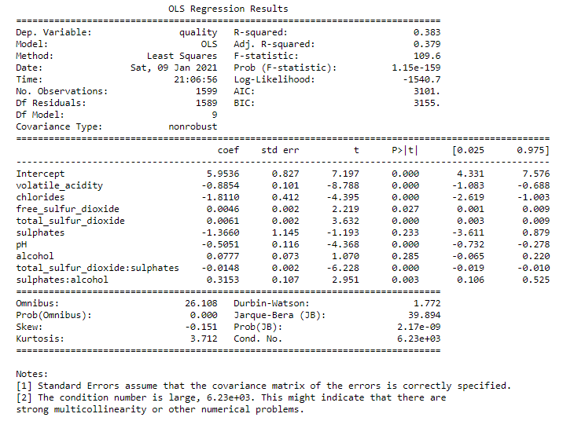
Model Building
So I decided to use interaction terms and my model got up to 38.3% with an adjusted r-squared of 37.9%

Slide 12
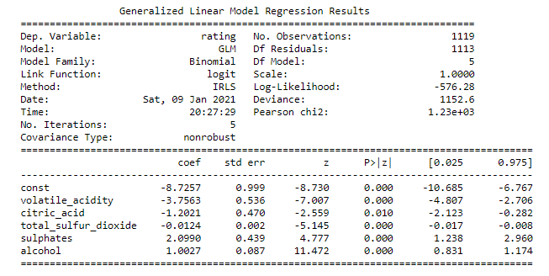
Model Building
For the logistic regression,I decided to do some feature selection first.
I conducted the same analysis technique using a generalized linear regression model and omitted the high p values .

Slide 13
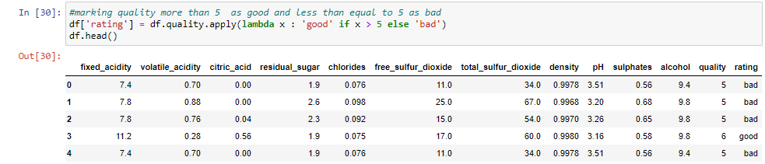
Model Building
As mentioned earlier , I solved this using 2 techniques , for classification I had to classify the quality features and turn them into rating of good and bad.

Slide 14
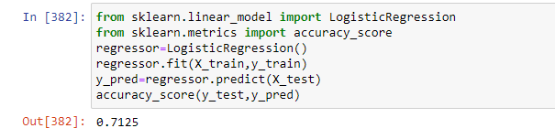
Model Building
I basically split the dataset into training and testing in this part giving 70% for the training X_train and putting the quality in y_train and 30% in X_test and y_test.
After splitting the dataset into train and test and after removing high p-values features from the train dataframe , I drop the same features in the test dataframe.
Now let’s solve it using classification algorithm “Logistic Regression” and see the results.
Calculated the accuracy score(prediction power) and got 71% accuracy.

Slide 15
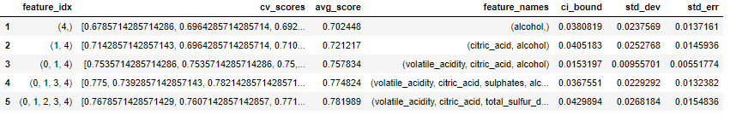
Model Building
Then I used step forward selection to see how our model reacts with different independent variables.
The avg_score gives 70% with alcohol alone and jumps the highest when volatile acidity is added.

Slide 16
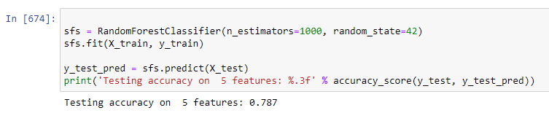
Model Building
We got 79% accuracy when we validate our test data on train data.

Slide 17
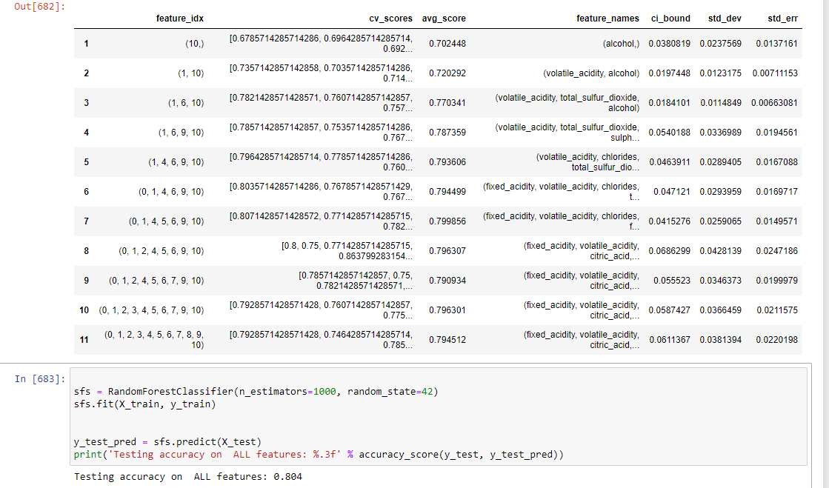
Model Building
I did the same with ALL features and the model only got better by 1 %. Giving us 80% accuracy
Previous Random regression model is definitely better because it saves time on the training and testing (future data).

Slide 18
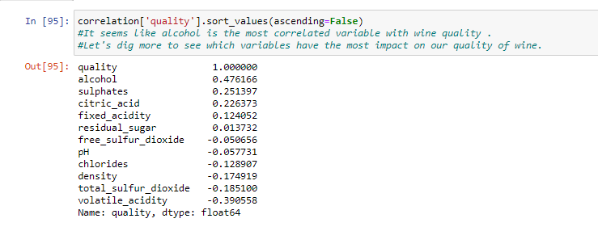
Insights from analysis
Viewing the dataset as a classification task gave me better results.
Random Forest with step forward selection ( SFS) performed better than logistic regression.
We conclude that alcohol (major) followed by volatile acidity and citric_acid are the most contributors to determine the quality.

Slide 19


Thank you

